Slide 1

Chapter 1
Introduction
Copyright © The McGraw-Hill Companies, Inc. Permission required for reproduction or display.
Notes:
‹#›

Slide 2
Chapter 1: Outline
1.1 Data Communications
1.2 Networks
1.3 Network Types
1.4 Internet History
1.5 Standards and Administration
Notes:
1.#

Slide 3

Chapter 1: Objective
The first section introduces data communications and defines their components and the types of data exchanged. It also shows how different types of data are represented and how data is flowed through the network.
The second section introduces networks and defines their criteria and structures. It introduces four different network topologies that are encountered throughout the book.
The third section discusses different types of networks: LANs, WANs, and internetworks (internets). It also introduces the Internet, the largest internet in the world. The concept of switching is also introduced in this section to show how small networks can be combined to create larger ones.
Notes:
1.#

Slide 4
Chapter 1: Objective (continued)
The fourth section covers a brief history of the Internet. The section is divided into three eras: early history, the birth of the Internet, and the issues related to the Internet today. This section can be skipped if the reader is familiar with this history.
The fifth section covers standards and standards organizations. The section covers Internet standards and Internet administration. We refer to these standards and organizations throughout the book.
Notes:
1.#

Slide 5
1-1 DATA COMMUNICATIONS
When we communicate, we are sharing information. This sharing can be local or remote. The term telecommunication, which includes telephony, telegraph, and television, means communication at a distance.
Data communications are the exchange of data between two devices via some form of transmission media.
1.‹#›
Notes:
1.#

Slide 6
1.1.1 Components
A data communications system has five components (see Figure 1.1).
1.‹#›
Notes:
1.#

Slide 7
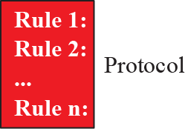
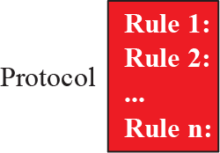



Figure 1.1: Five components of data communication
1.‹#›
Notes:
1.#

Slide 8
1.1.2 Data Representation
Information today comes in different forms such as text, numbers, images, audio, and video.
1.‹#›
Notes:
1.#

Slide 9
1.1.3 Data Flow
Communication between two devices can be simplex, half-duplex, or full-duplex as shown in Figure 1.2.
1.‹#›
Notes:
1.#

Slide 10
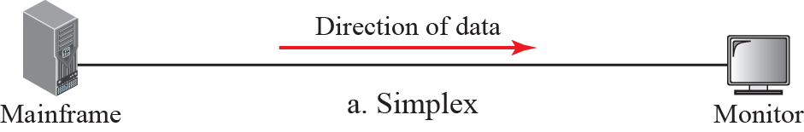
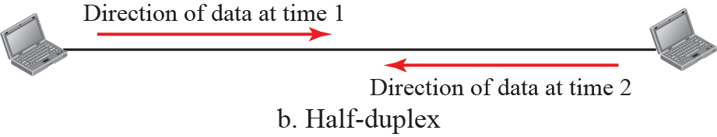
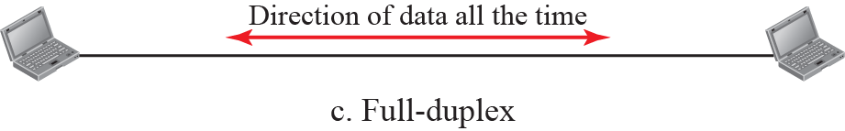
Figure 1.2: Data flow
1.‹#›
Notes:
1.#

Slide 11
1-2 NETWORKS
A network is the interconnection of a set of devices capable of communication. In this definition, a device can be a host such as a large computer, desktop, laptop, workstation, cellular phone, or security system. A device in this definition can also be a connecting device such as a router a switch, a
modem that changes the form of data, and so on.
1.‹#›
Notes:
1.#

Slide 12
1.2.1 Network Criteria
A network must be able to meet a certain number of criteria. The most important of these are performance, reliability, and security.
1.‹#›
Notes:
1.#

Slide 13
1.2.2 Physical Structures
Before discussing networks, we need to define some network attributes.
1.‹#›
Notes:
1.#

Slide 14
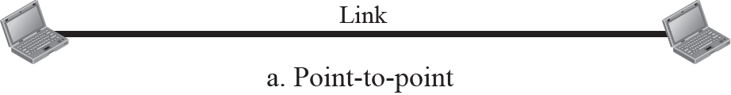
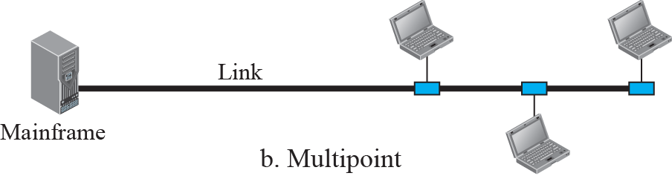
Figure 1.3: Types of connection
1.‹#›
Notes:
1.#

Slide 15
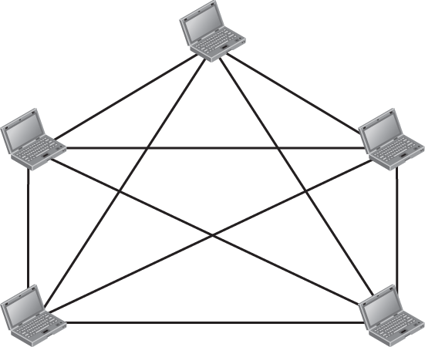


Figure 1.4: A fully-connected mesh topology
1.‹#›
Notes:
1.#

Slide 16
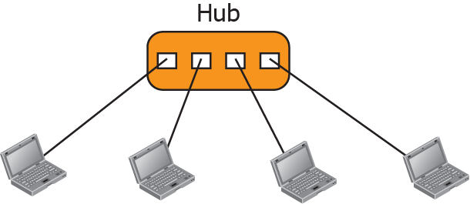
Figure 1.5: A star topology
1.‹#›
Notes:
1.#

Slide 17
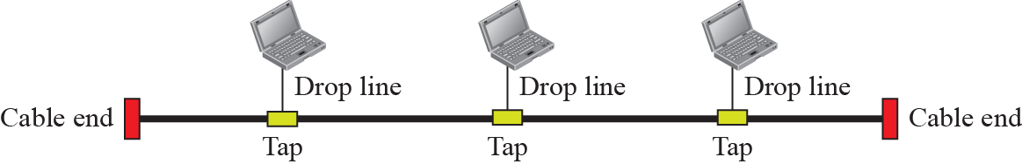
Figure 1.6: A bus topology
1.‹#›
Notes:
1.#

Slide 18
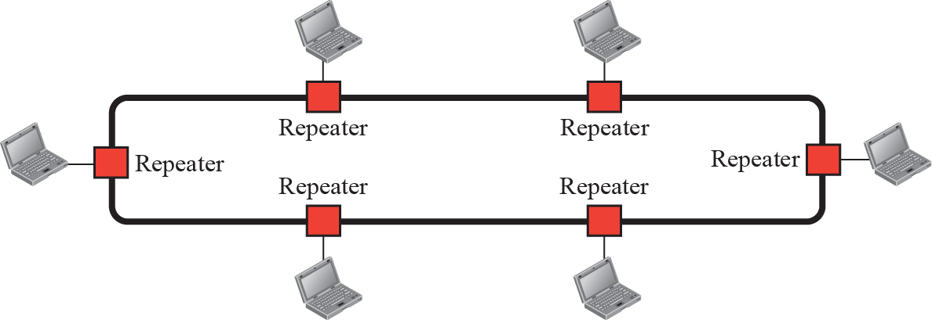
Figure 1.7: A ring topology
1.‹#›
Notes:
1.#

Slide 19
1-3 NETWORKS TYPES
After defining networks in the previous section and discussing their physical structures, we need to discuss different types of networks we encounter in the world today. The criteria of distinguishing one type of network from another is difficult and sometimes confusing. We use a few criteria such as size, geographical coverage, and ownership to make this distinction.
1.‹#›
Notes:
1.#

Slide 20
1.3.1 Local Area Network
A local area network (LAN) is usually privately owned and connects some hosts in a single office, building, or campus. Depending on the needs of an organization, a LAN can be as simple as two PCs and a printer in someone’s home office, or it can extend throughout a company and include audio and video devices. Each host in a LAN has an identifier, an address, that uniquely defines the host in the LAN. A packet sent by a host to another host carries both the source host’s and the destination host’s addresses.
1.‹#›
Notes:
1.#

Slide 21
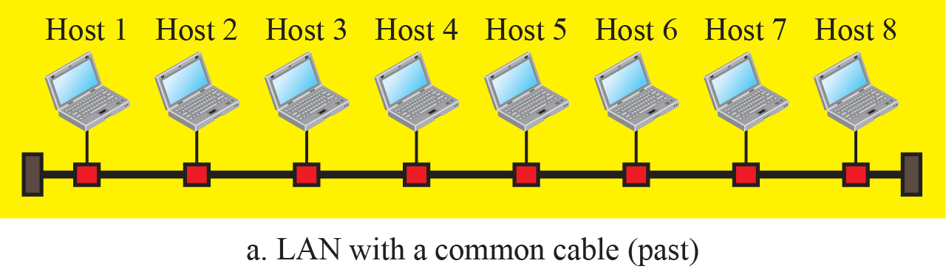
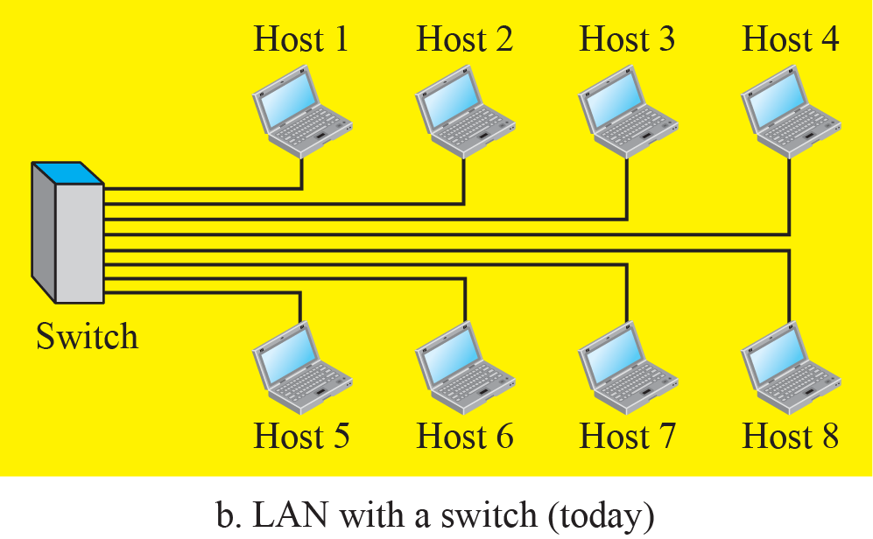
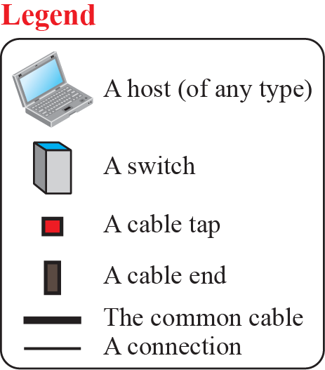
Figure 1.8: An Isolated LAN in the past and today
1.‹#›
Notes:
1.#

Slide 22
1.3.2 Wide Area Network
A wide area network (WAN) is also an connection of devices capable of communication. However, there are some differences between a LAN and a WAN. A LAN is normally limited in size; a WAN has a wider geographical span, spanning a town, a state, a country, or even the world. A LAN interconnects hosts; a WAN interconnects connecting devices such as switches, routers, or modems. A LAN is normally privately owned by the organization that uses it; a WAN is normally created and run by communication companies and leased by an organization that uses it.
1.‹#›
Notes:
1.#

Slide 23
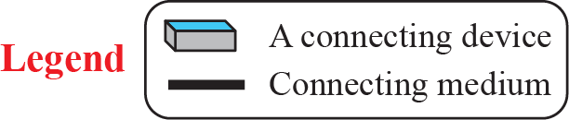
Figure 1.9: A Point-to-Point WAN
1.‹#›
Notes:
1.#

Slide 24
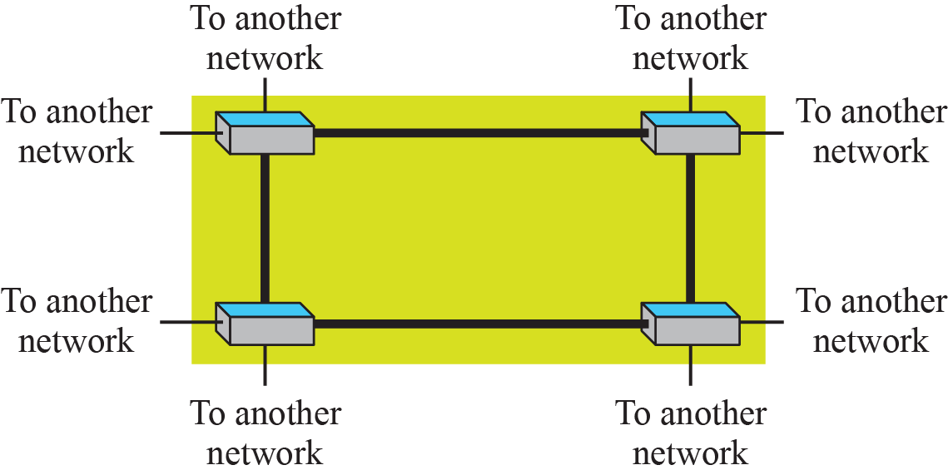
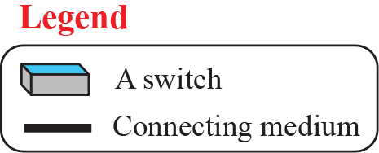
Figure 1.10: A Switched WAN
1.‹#›
Notes:
1.#

Slide 25
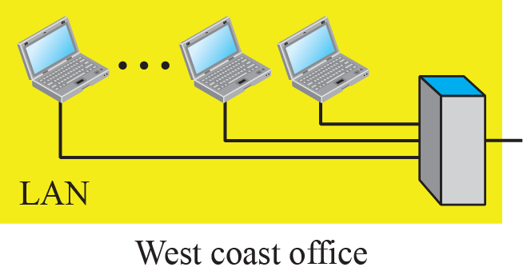
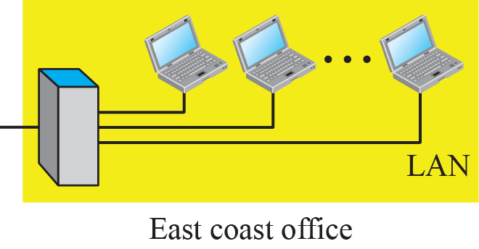
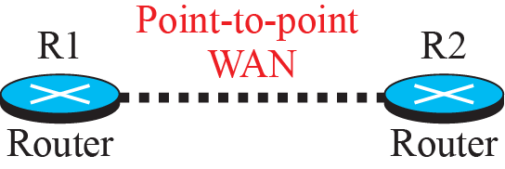
Figure 1.11: An internetwork made of two LANs and one WAN
1.‹#›
Notes:
1.#

Slide 26

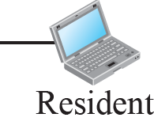
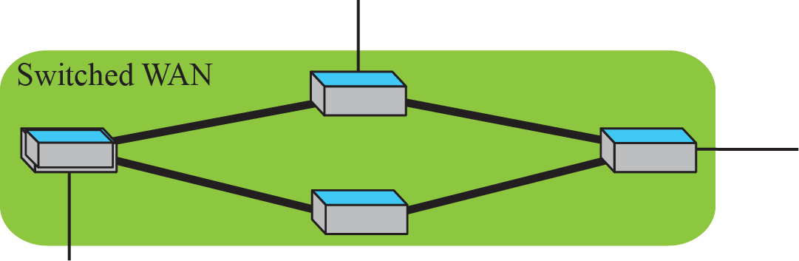
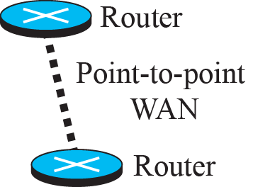
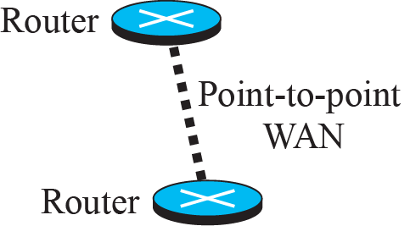
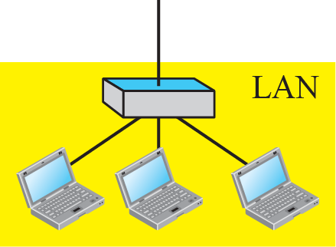
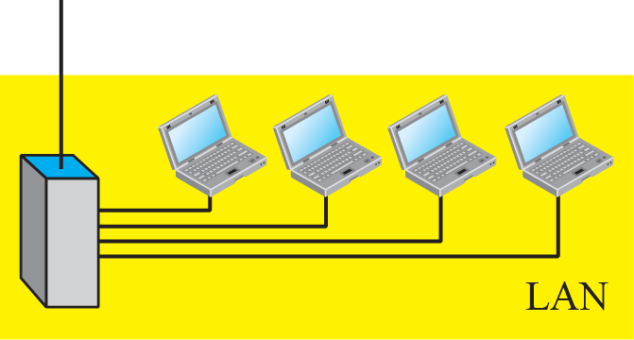
Figure 1.12: A heterogeneous network made of WANs and LANs
1.‹#›
Notes:
1.#

Slide 27
1.3.3 Switching
An internet is a switched network in which a switch connects at least two links together. A switch needs to forward data from a network to another network when required. The two most common types of switched networks are circuit-switched and packet-switched networks. We discuss both next.
1.‹#›
Notes:
1.#

Slide 28

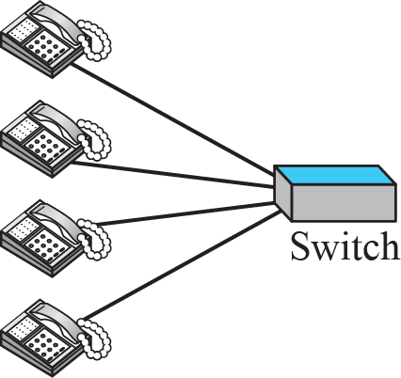
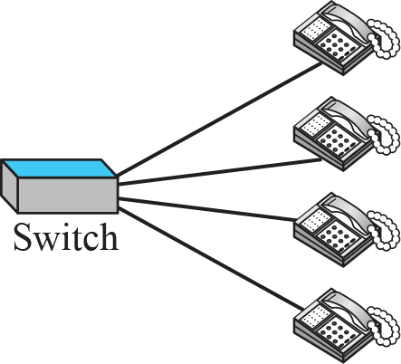
Figure 1.13: A circuit-switched network
1.‹#›
Notes:
1.#

Slide 29

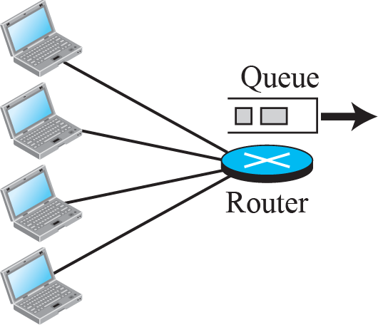
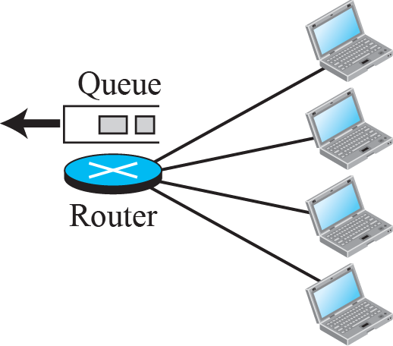
Figure 1.14: A packet-switched network
1.‹#›
Notes:
1.#

Slide 30
1.3.4 The Internet
As we discussed before, an internet (note the lowercase i) is two or more networks that can communicate with each other. The most notable internet is called the Internet (uppercase I ), and is composed of thousands of interconnected networks. Figure 1.15 shows a conceptual (not geographical) view of the Internet.
1.‹#›
Notes:
1.#

Slide 31
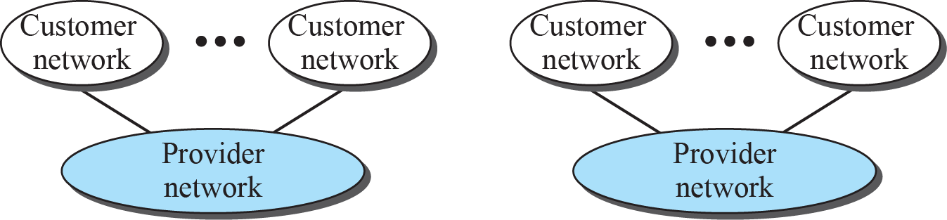
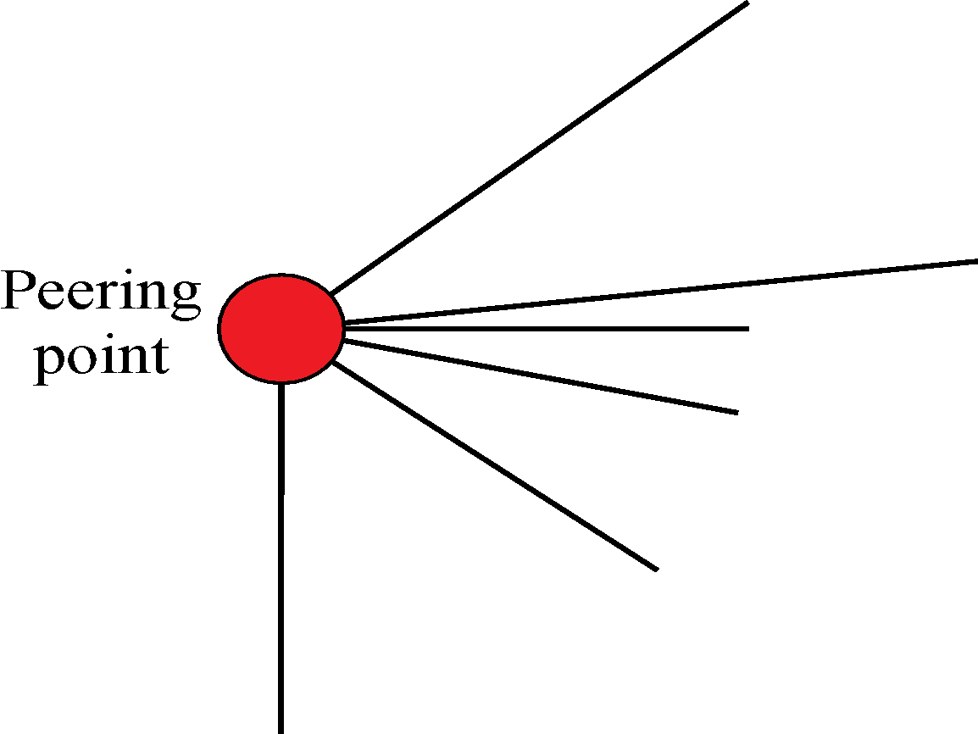

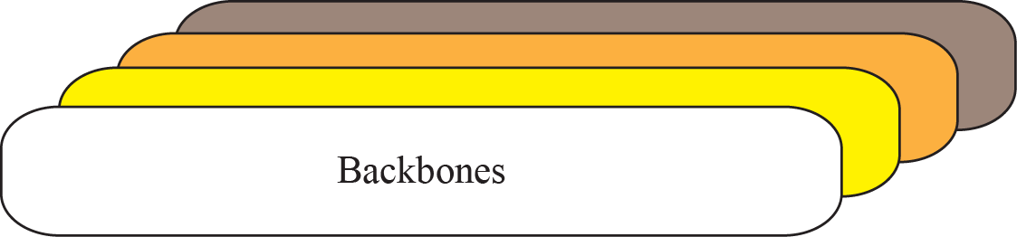
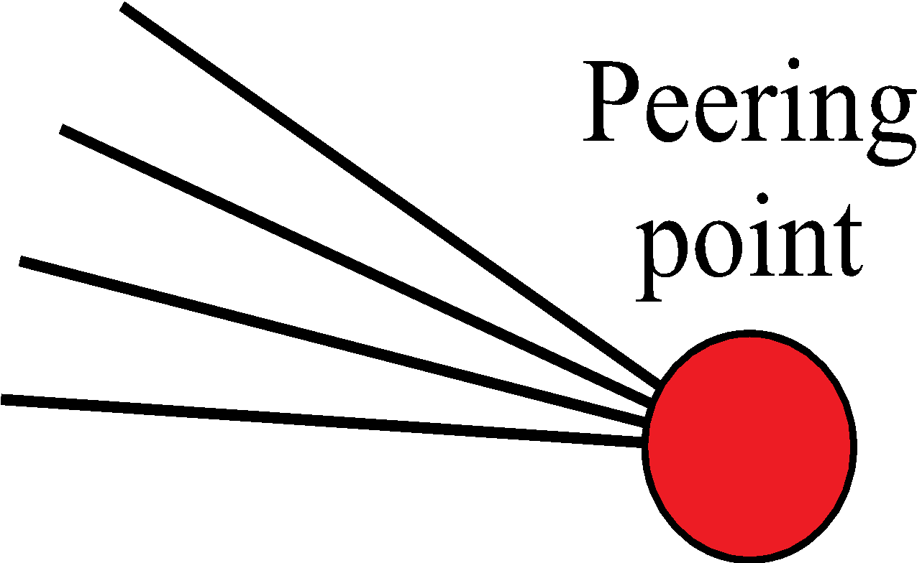

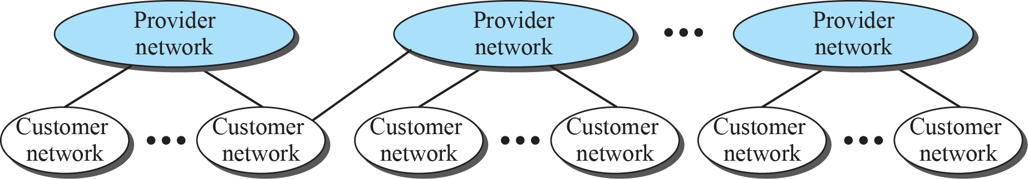
Figure 1.15: The Internet today
1.‹#›
Notes:
1.#

Slide 32
1.3.5 Accessing the Internet
The Internet today is an internetwork that allows any user to become part of it. The user, however, needs to be physically connected to an ISP. The physical connection is normally done through a point-to-point WAN. In this section, we briefly describe how this can happen, but we postpone the technical details of the connection until Chapters 14 and 16.
1.‹#›
Notes:
1.#

Slide 33
1-4 INTERNET HISTORY
Now that we have given an overview of the Internet and its protocol, let us give a brief history of the Internet. This brief history makes it clear how the Internet has evolved from a private network to a global one in less than forty years.
1.‹#›
Notes:
1.#

Slide 34
1.4.1 Early History
There were some communication networks, such as telegraph and telephone networks, before 1960. These networks were suitable for constant-rate communication at that time, which means that after a connection was made between two users, the encoded message (telegraphy) or voice (telephony) could be exchanged. A computer network, on the other hand, should be able to handle bursty data, which means data received at variable rates at different times. The world needed to wait for the packet-switched network to be invented.
1.‹#›
Notes:
1.#

Slide 35
1.4.2 Birth of the Internet
In 1972, Vint Cerf and Bob Kahn, both of whom were part of the core ARPANET group, collaborated on what they called the Internetting Project. They wanted to link dissimilar networks so that a host on one network could communicate with a host on another. There were many problems to overcome: diverse packet sizes, diverse interfaces, and diverse transmission rates, as well as differing reliability requirements. Cerf and Kahn devised the idea of a device called a gateway to serve as the intermediary hardware to transfer data from one network to another.
1.‹#›
Notes:
1.#

Slide 36
1.4.3 Internet Today
Today, we witness a rapid growth both in the infrastructure and new applications. The Internet today is a set of pier networks that provide services to the whole world. What has made the Internet so popular is the invention of new applications.
1.‹#›
Notes:
1.#

Slide 37
1-5 STANDARDS AND ADMINISTRATION
In the discussion of the Internet and its protocol, we often see a reference to a standard or an administration entity. In this section, we introduce these standards and administration entities for those readers that are not familiar with them; the section can be skipped if the reader is familiar with them.
1.‹#›
Notes:
1.#

Slide 38
1.5.1 Internet Standards
An Internet standard is a thoroughly tested specification that is useful to and adhered to by those who work with the Internet. It is a formalized regulation that must be followed. There is a strict procedure by which a specification attains Internet standard status. A specification begins as an Internet draft. An Internet draft is a working document (a work in progress) with no official status and a six-month lifetime.
1.‹#›
Notes:
1.#

Slide 39
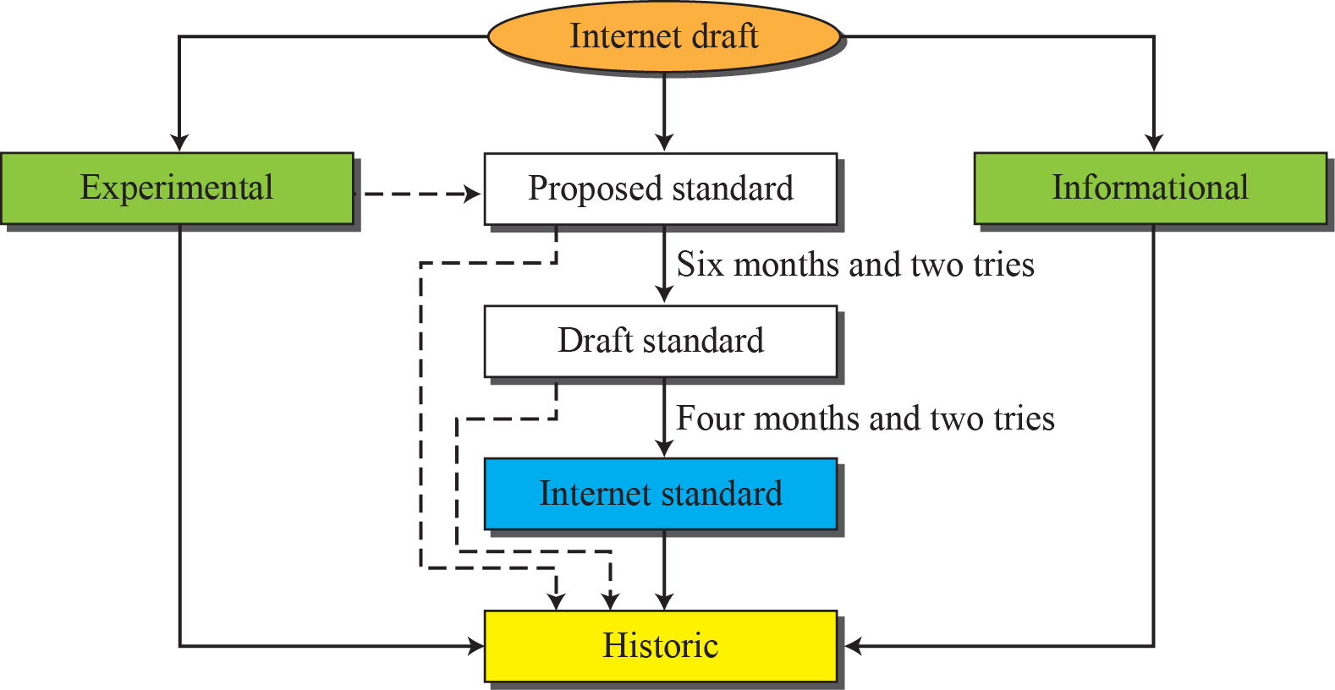
Figure 1.16: Maturity levels of an RFC
1.‹#›
Notes:
1.#

Slide 40
1.5.2 Internet Administration
The Internet, with its roots primarily in the research domain, has evolved and gained a broader user base with significant commercial activity. Various groups that coordinate Internet issues have guided this growth and development. Appendix G gives the addresses, e-mail addresses, and telephone numbers for some of these groups. Figure 1.17 shows the general organization of Internet administration.
1.‹#›
Notes:
1.#

Slide 41
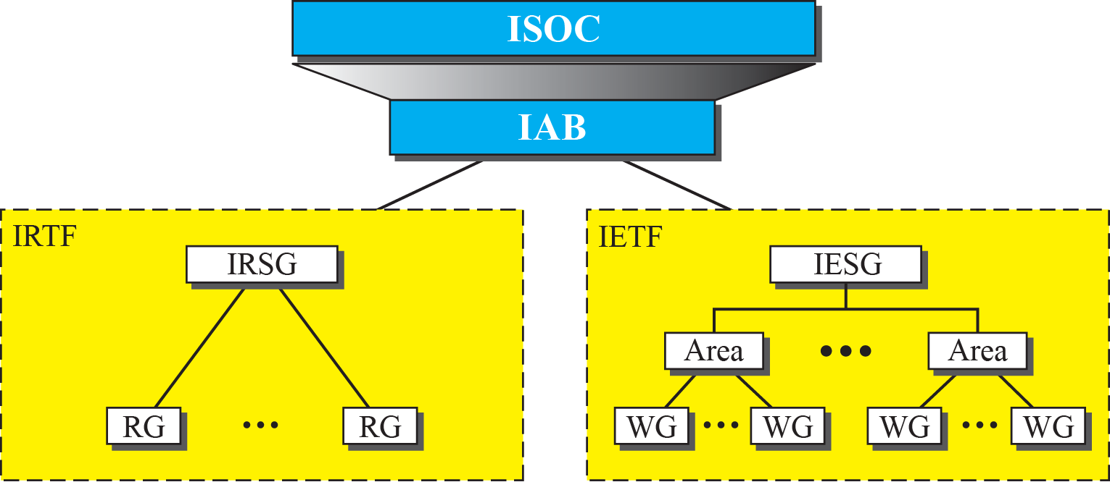
Figure 1.17: Internet administration
1.‹#›
Notes:
1.#

